Slide 1
Irish History Podcast Project (Phase Three): Client-ready dataviz
Use the following slides to collect your client-ready data visualizations. Note that this presentation does not need to be stylized in any way, it is simply a way to submit the visualizations. Create as many additional pages you need to accommodate your visuals.
Swathi Ganesan

Slide 2
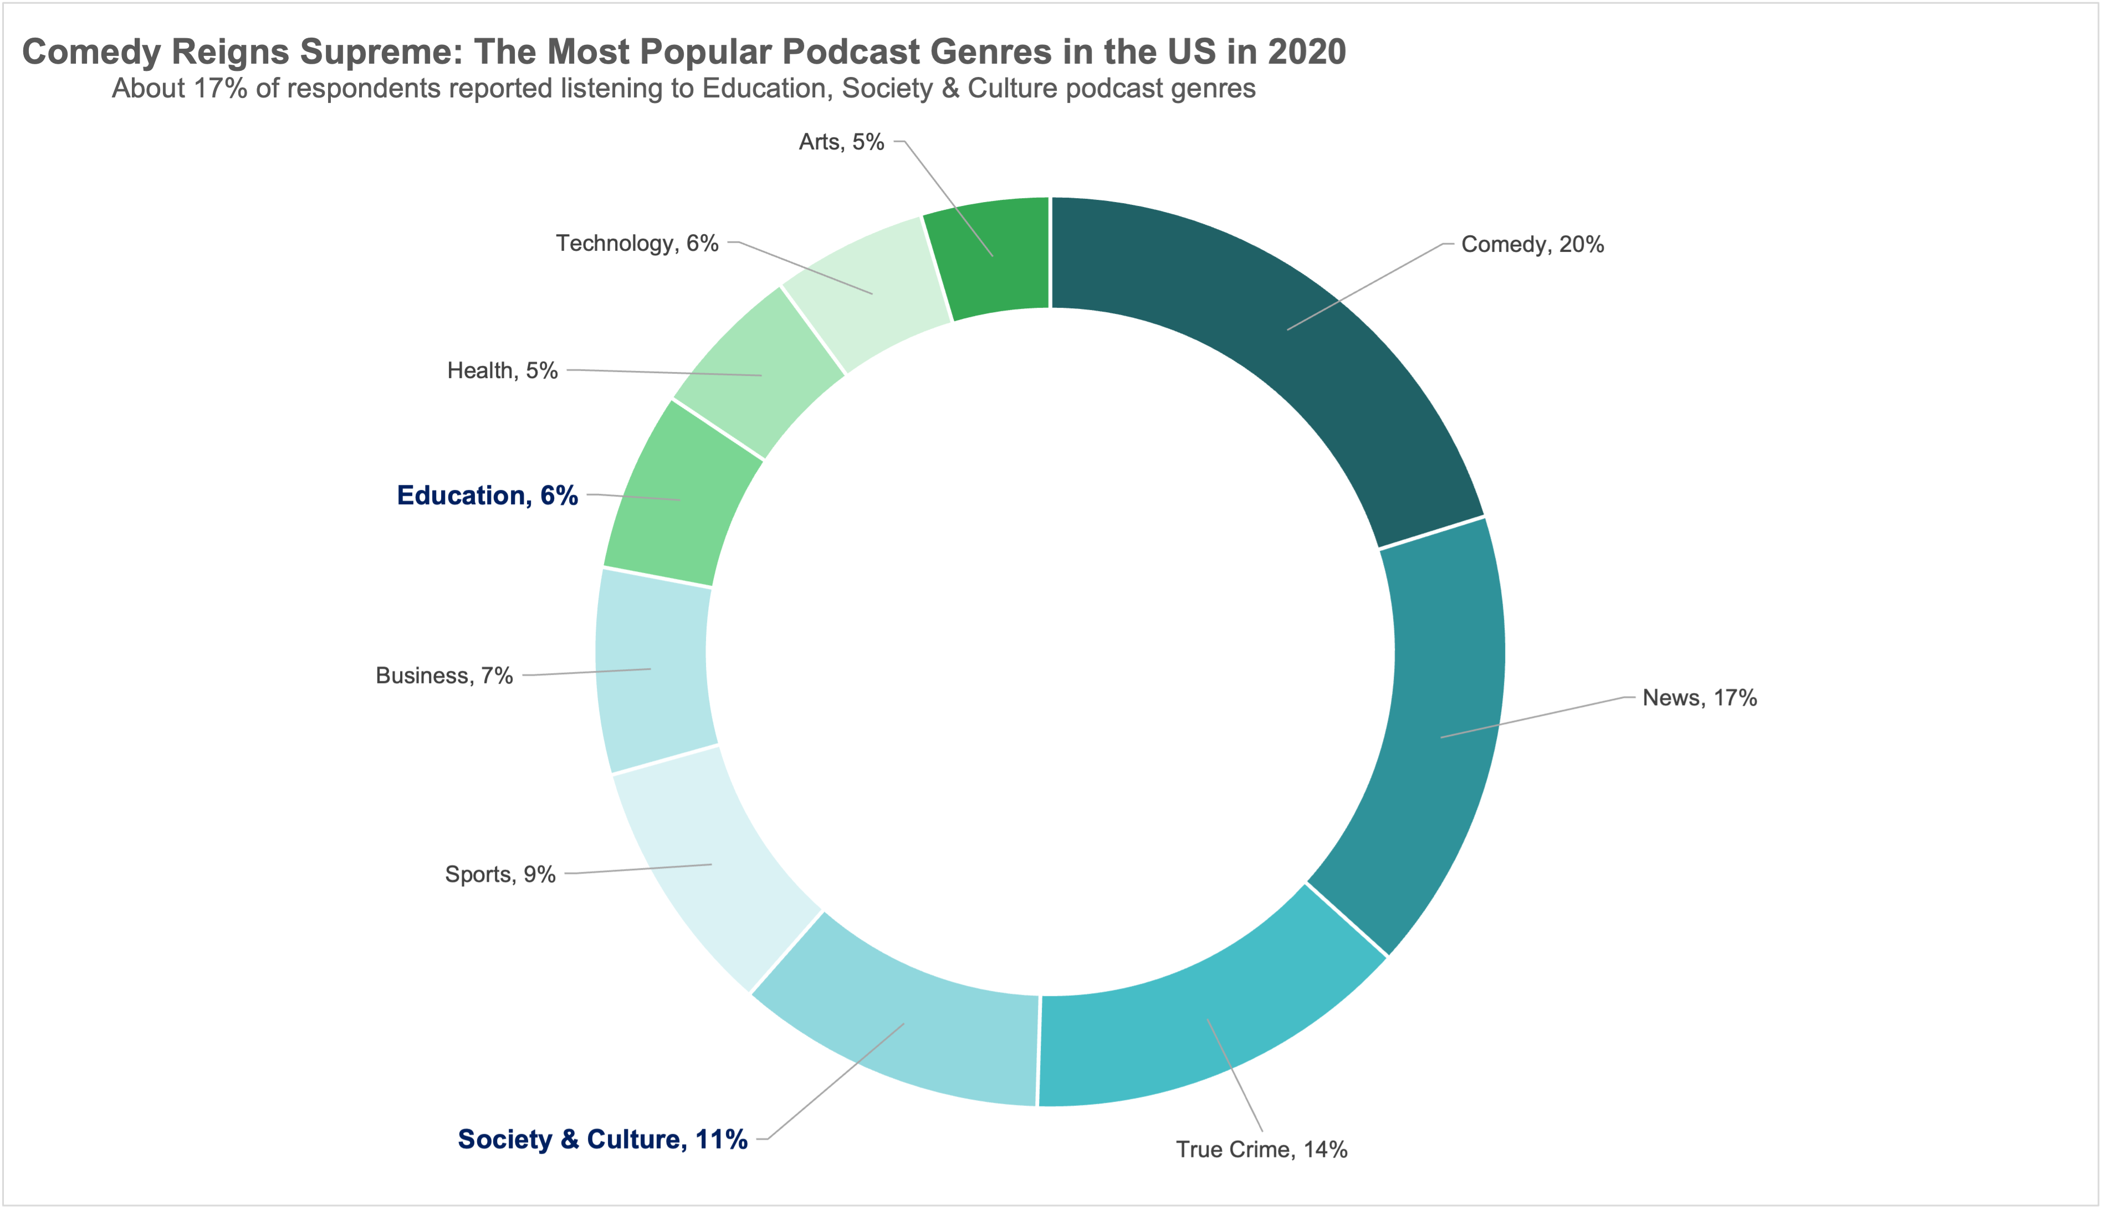
Visual ONE
source : Edison Research Infinite Dial report, 2022

Slide 3
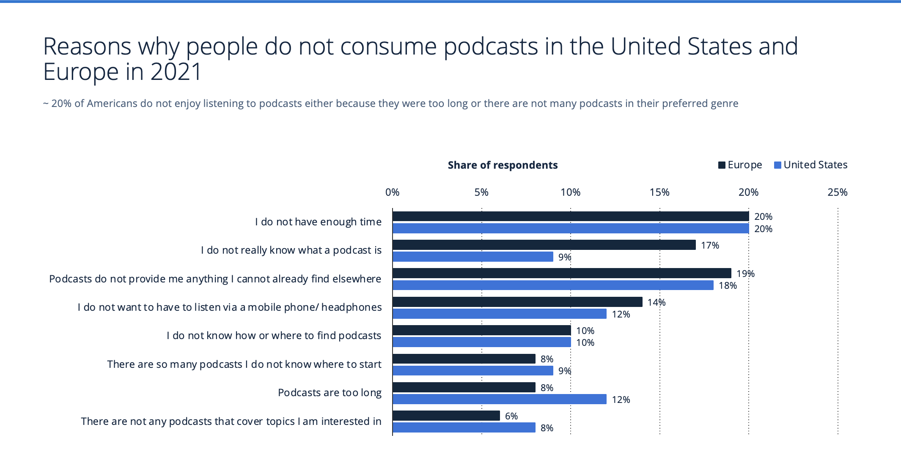
Visual TWO
* surveyed U.S.: 1,248; Europe: 30,234; 18 years and older; among people who have not listened to a podcast in the last month

Slide 4
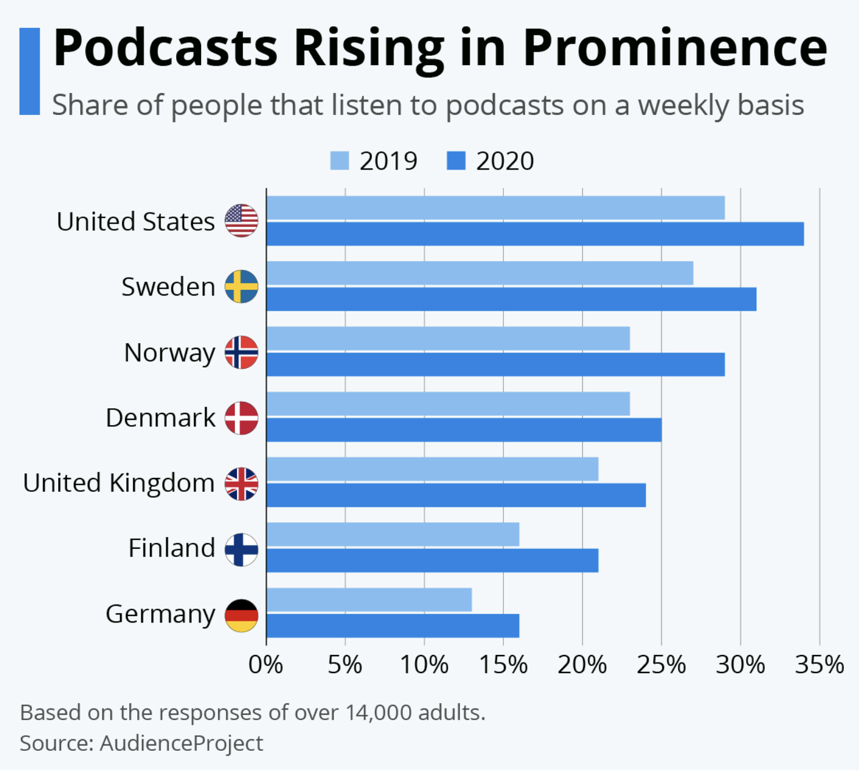
Visual THREE

Slide 5
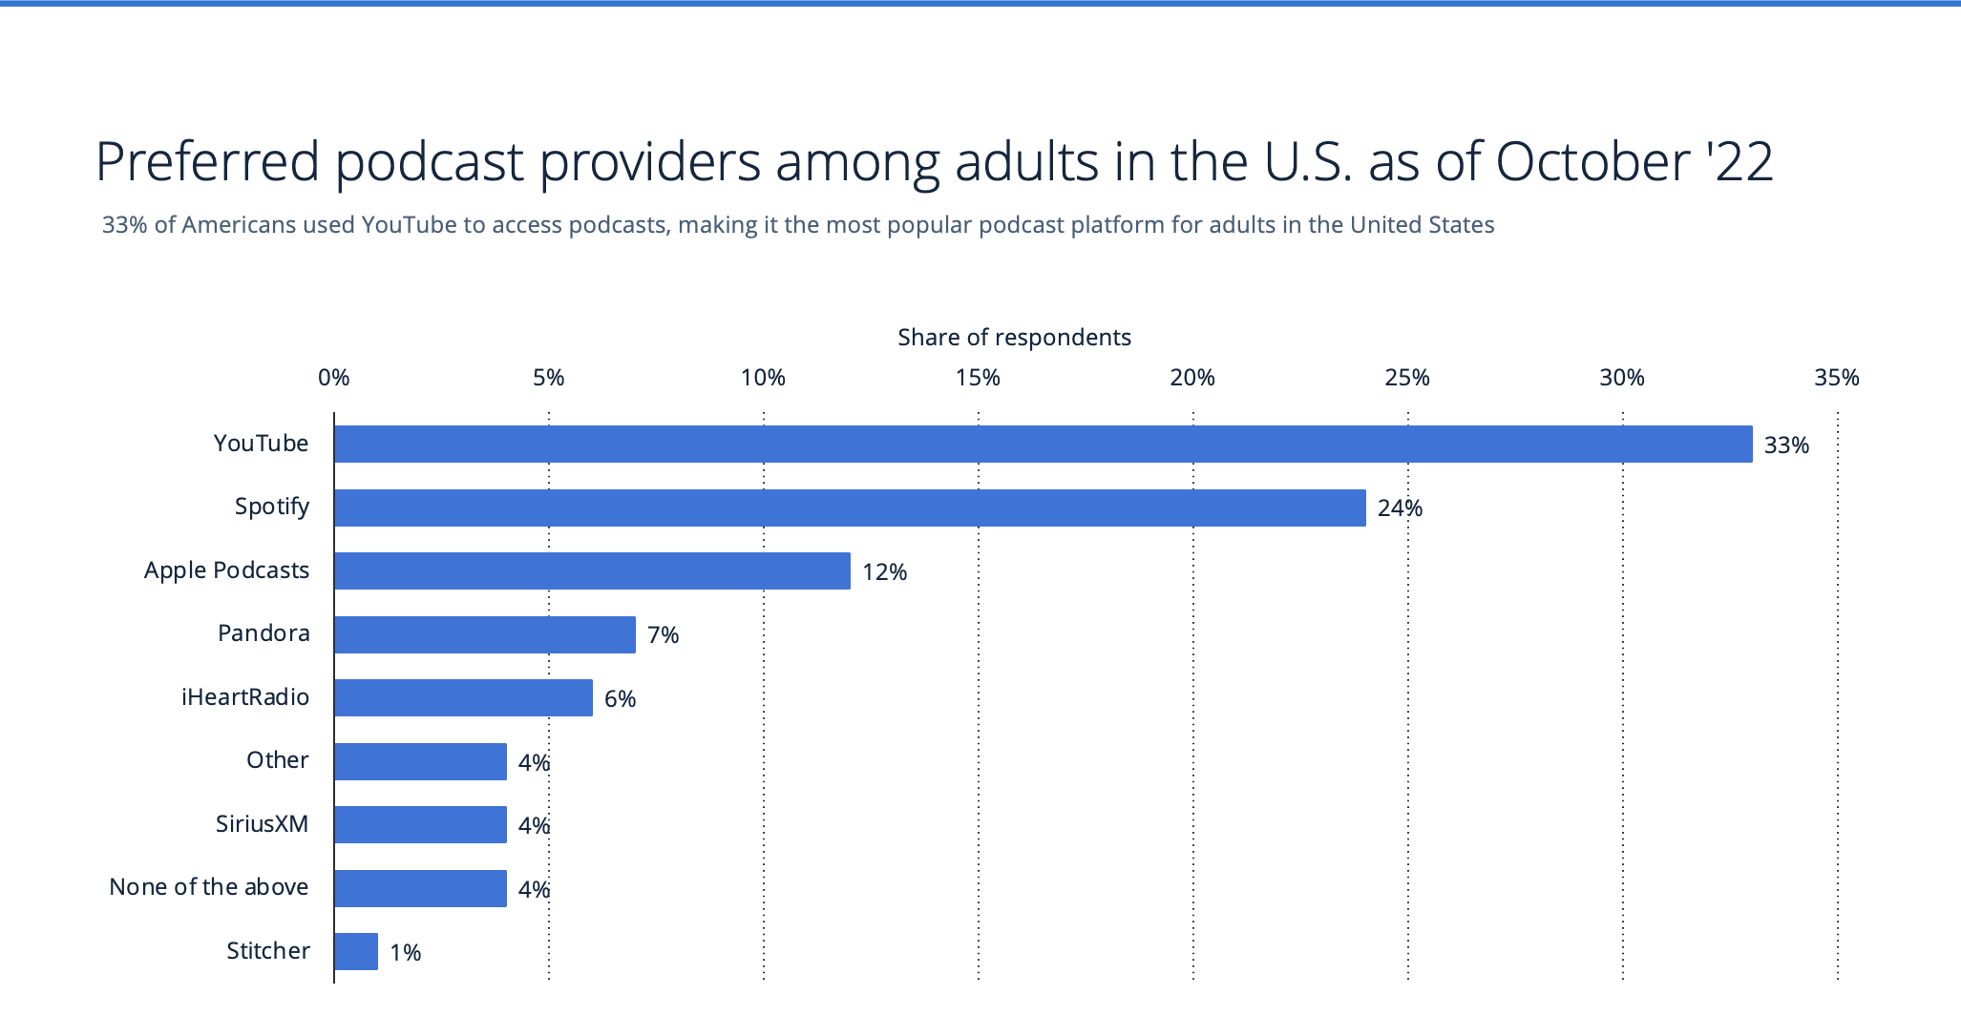
Visual FOUR
* surveyed 1,172 respondents; 18 years and older

Slide 6
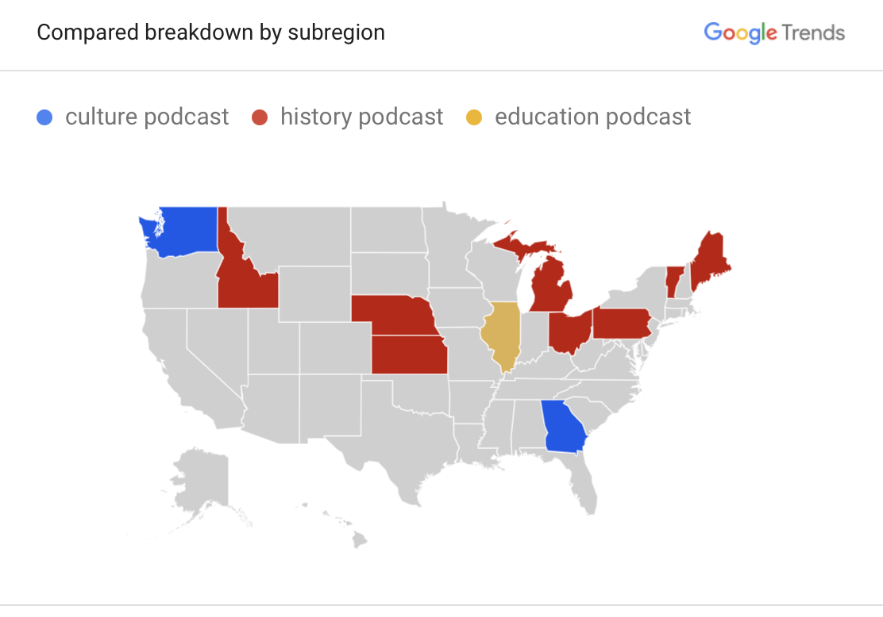
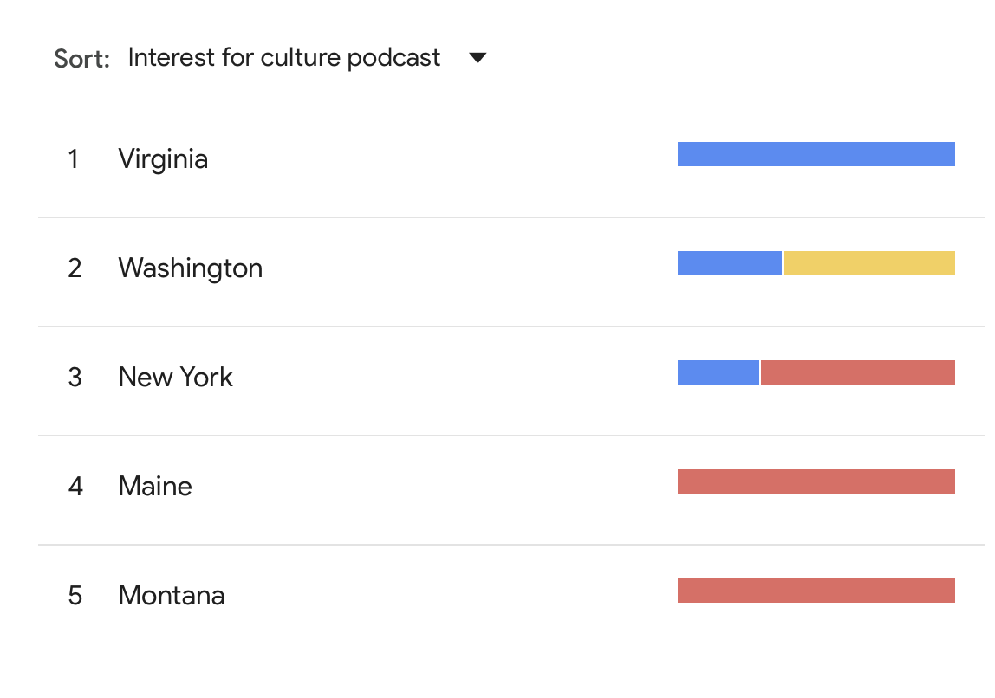
Visual FIVE
Top regions in the United States with interest in culture, history and education podcasts

Slide 7
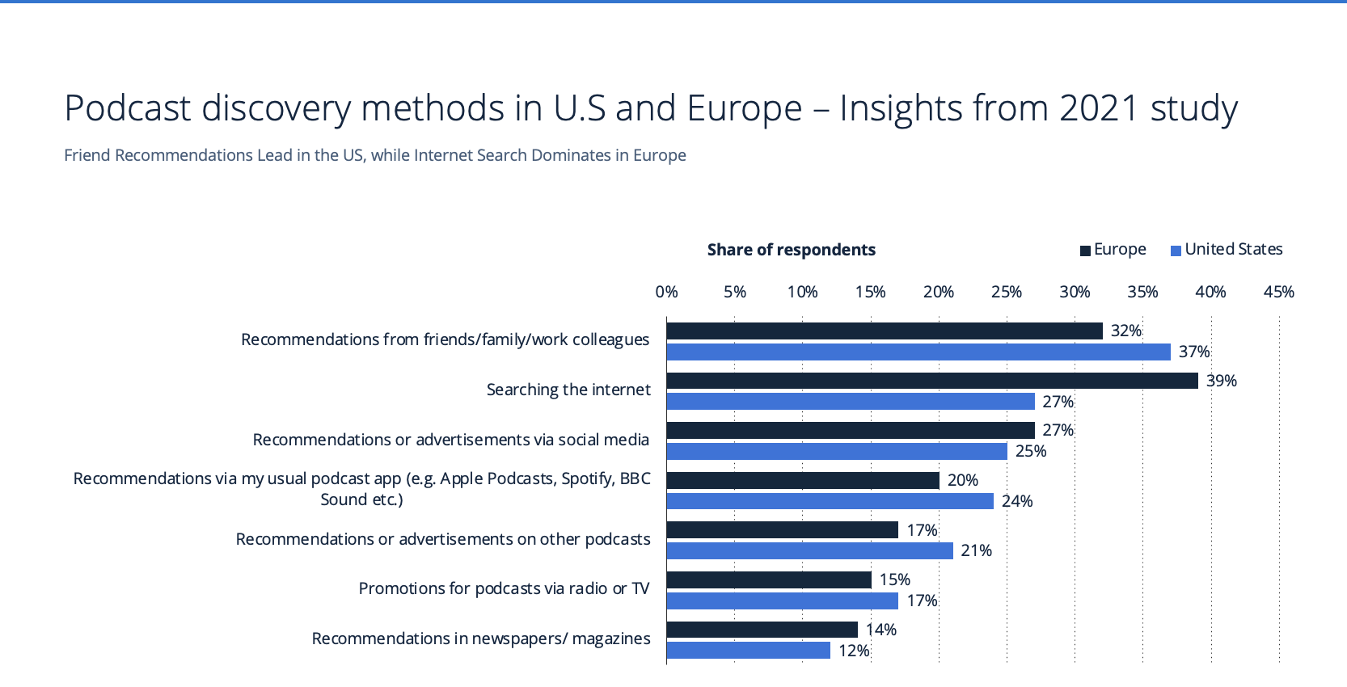
Visual SIX
* surveyed U.S.: 753; Europe:18,180; 18 years and older; among those who listened to a podcast in the last month

Slide 8
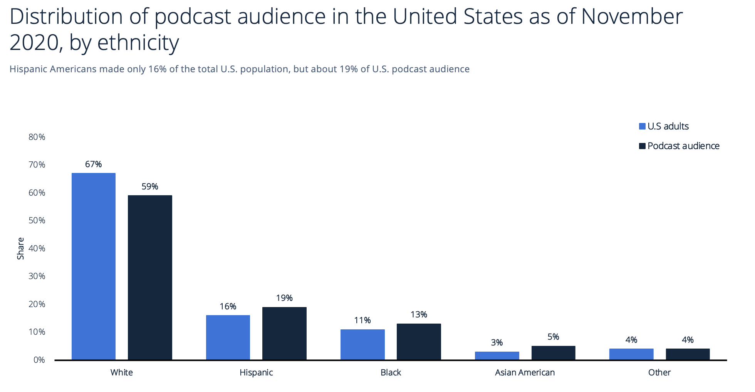
Visual SEVEN
* surveyed 1,172 respondents; 18 years and older

Slide 9
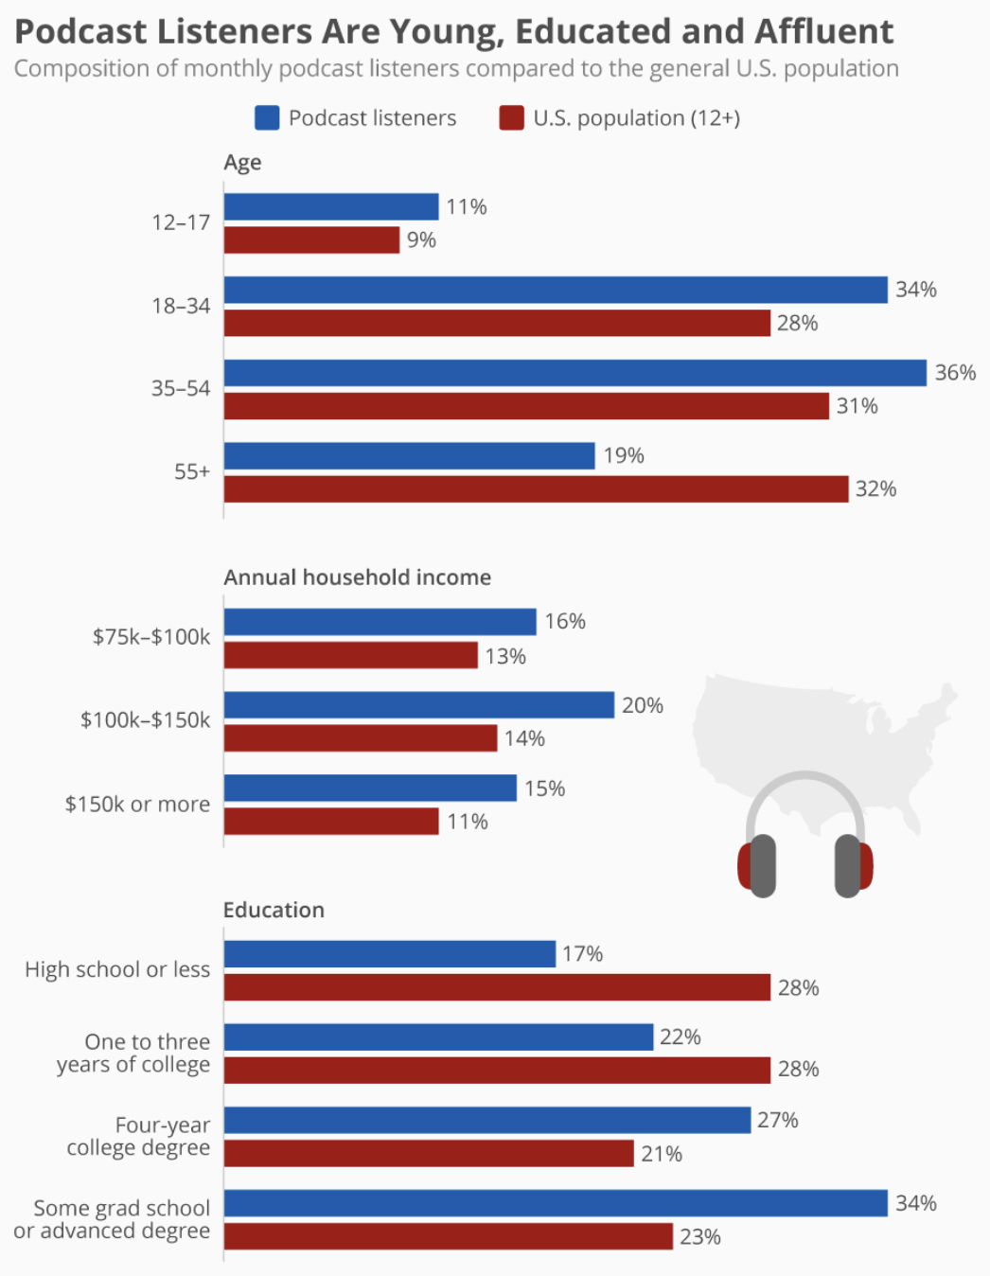
Visual EIGHT
* surveyed 2,000 Americans aged 12+

Slide 10
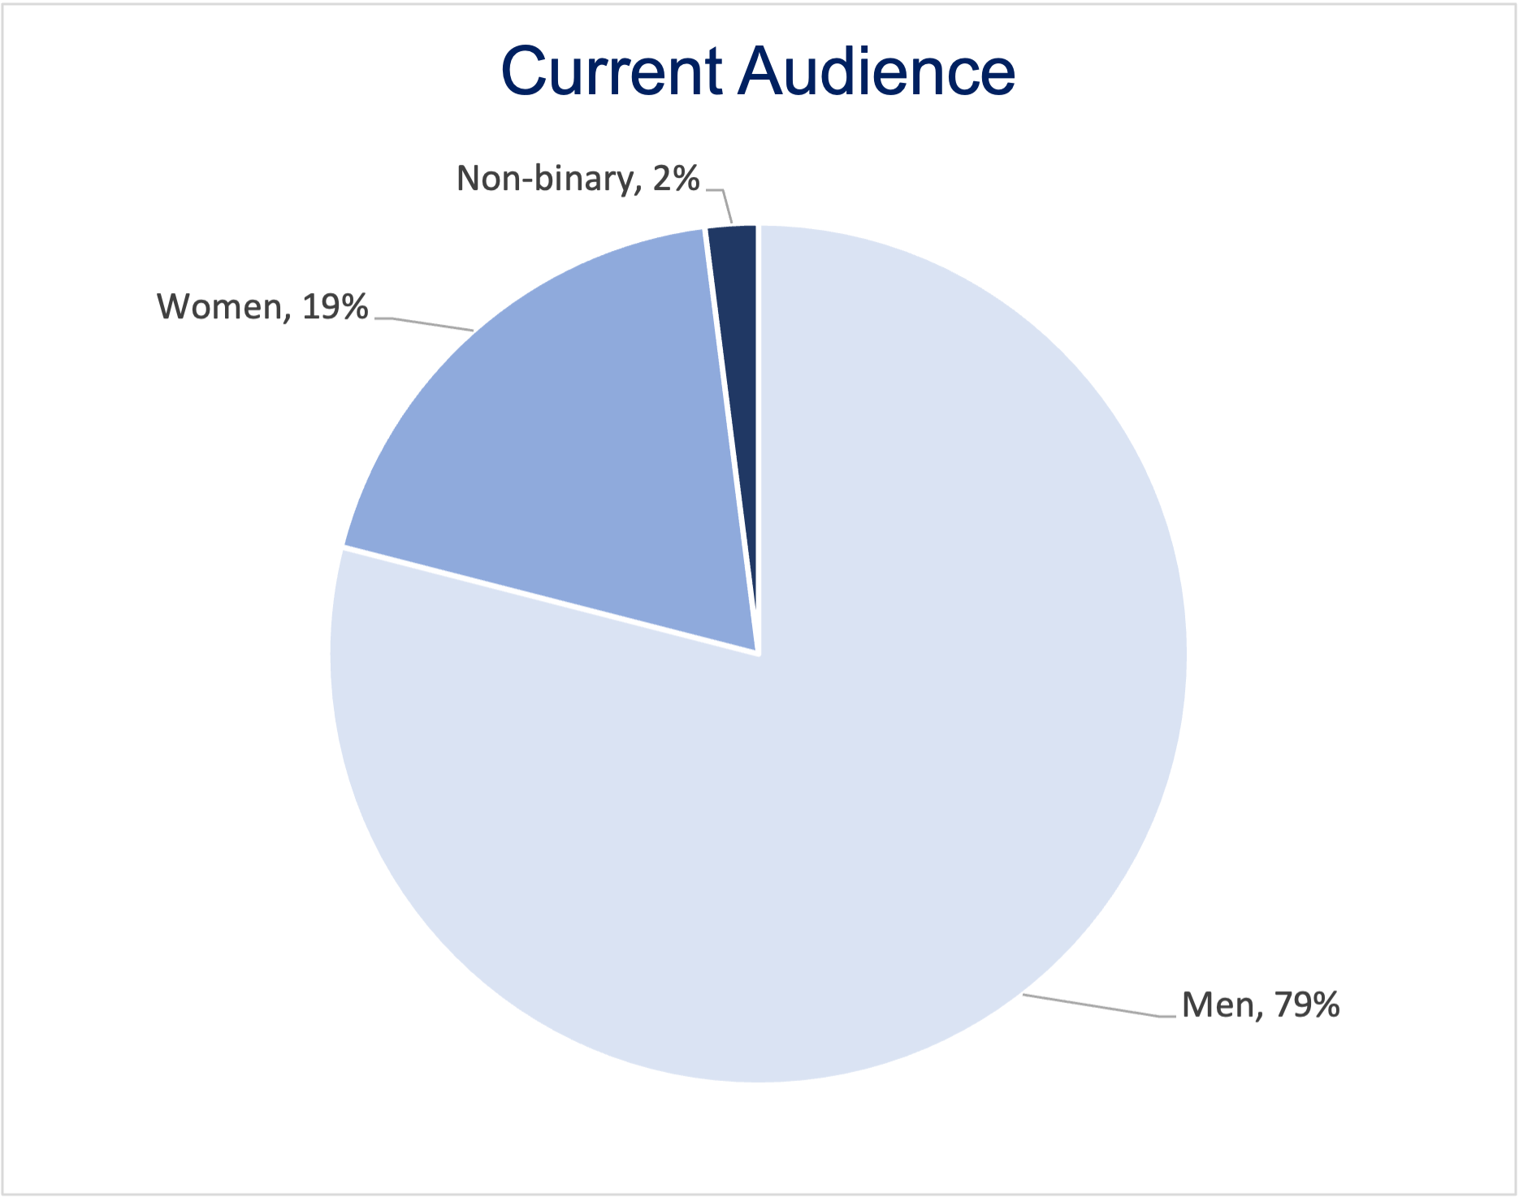
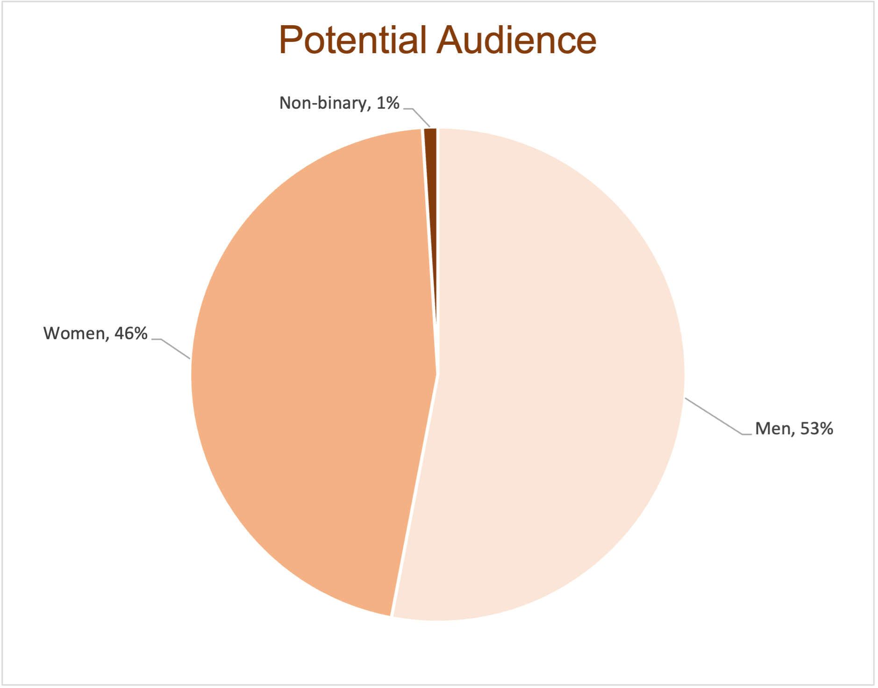
Visual NINE
Gender distribution comparison between current Irish history podcast listeners and potential US podcast listeners

